Slide 1

Advanced Software Engineering
Lecture 1:
Introduction to Software Engineering
Prof. Harold Liu

Slide 2
Content
Basic concept of software engineering
Computer-based system engineering
Software process
Basic elements of software project management

Slide 3
1. What is Software？
Software=program+data+document
  Customized software
  Generic software, Shrink-wrapped software
  Embedded software
  Safety-critical software
  COTS (Commercial Off-the-Shelf)
“I will create a software to update the database”.
(some software, a piece of software, a software system)
Categorized by its functionalities, scale/size, operational method, required reliability, etc.
Notes:
shrink-wrapped software - software on CD-ROMs that are boxed and shrink-wrapped and sold in stores (implying a widely supported standard platform)
embedded software has fixed hardware requirements and capabilities
Unlike standard computers that use only a few operating systems (MacOS, Windows and to some extent, Linux), embedded software comes in a wide variety of operating systems, typically a real-time operating system. This runs from small one-person operations consisting of a run loop and a timer, to LynxOS, VxWorks, BeRTOS, ThreadX, to Windows CE or Linux (with patched kernel). Others include OpenWrt, PikeOS, eCos, Fusion RTOS, Nucleus RTOS, RTEMS, INTEGRITY, uC/OS, QNX and OSE. Code is typically written in C or C++. Ada is used in some military and aviation projects.

Slide 4
2. What is Software Engineering?
Fall, 1968, NATO Technical Committee convened nearly 50 first-class programmers, computer scientists and industry giants, discuss how to cope with "software crisis". Fritz Bauer at the meeting for the first time put forward the "Software Engineering" concept.
The establishment and use of sound engineering principles in order to obtain economically software that is reliable and works efficiently on real machines.” --- Fritz Bauer, 1968
Notes:
软件危机（software crisis），20 世纪60年代以前，计算机刚刚投入实际使用，软件设计往往只是为了一个特定的应用而在指定的计算机上设计和编制，采用密切依赖于计算机的机器代码或汇编语言，软件的规模比较小，文档资料通常也不存在，很少使用系统化的开发方法，设计软件往往等同于编制程序，基本上是个人设计、个人使用、个人操作、自给自足的私人化的软件生产方式。
60年代中期，大容量、高速度计算机的出现，使计算机的应用范围迅速扩大，软件开发急剧增长。高级语言开始出现；操作系统的发展引起了计算机应用方式的变化；大量数据处理导致第一代数据库管理系统的诞生。软件系统的规模越来越大，复杂程度越来越高，软件可靠性问题也越来越突出。原来的个人设计、个人使用的方式不再能满足要求，迫切需要改变软件生产方式，提高软件生产率，软件危机开始爆发 。

Slide 5
IEEE Definition: Software engineering is
(1) the systematic, standardized, measurable method is applied to software development, operation and maintenance of the process, the upcoming engineering applied to software development process thinking
(2) research into (1)
Software engineering goals: low-cost, high-quality, on-time delivery

Slide 6
Essential Characteristics of Software Engineering
Concerned about the construction of large programs
How to control the complexity
Constantly changing software requirements
Aim at improving the efficiency of software development
Teamwork is key to its successful implementation
Software must effectively support its users
Cultural background difference for software product creation.

Slide 7
5. What is Software Process？
Software process is the development of software products for a group of activities and their results.
All software process contains four basic activities: Software description, software development, software validation and software evolution.
Different software processes organized in different ways in these four activities, which may affect the results of the progress of events.
Different bodies may be used to produce the same type of process products.

Slide 8
Benefits
A software process defines that in order to achieve the goals, what people need, in what way, at what time, what kind of work done (Goal, Who, When, How, What)
For Customer, User, Developer, Manager, a widely applicable software process allows all stakeholders to better understand their role and others’ role, as what to do at what time.
Promote the integration process to obtain the "best software process.“
Make the company's internal training standardized.
Due to the repeatability of the software process, useful for the development schedule arrangements and cost estimates.

Slide 9
6. What is Software Process Model？
Software process model is built from a particular perspective on the nature of the software process description.
Software process model includes a variety of activities that are constituting the software process, software products, as well as all stakeholders.

Slide 10
From a different perspective of the software process described, one get a different type of process models:
Workflow model: Describes the sequence of a series of activities, inputs, outputs and inter-dependencie. Here we refer “Activities”as human activity.
Data stream or activity model: the software process described as a set of activities, each of which completes certain data conversion. The referred level of activity in this model is below the workflow model.
Role/action model: Describes the different roles involved in the software process and its responsible activities.

Slide 11
Paradigm, Methodology
Waterfall Model
Waterfall Model with Maintenance Circle
Waterfall Model with Prototyping
Spiral Model
V Model
Phased Development Model
Incremental and Iterative Model
Rational Unified Process

Slide 12
7. Costs and distributions
Software costs depend on the adopted software process and the type of software being developed.
General distribution of costs:
Description: Design: Development: Integ. and Test
(15 : 25 : 20 : 40)%
High-demand software systems: integration/testing can occupy upt to 50% : 50%
software evolution
maintenance
Web-based e-commerce system
Notes:
描述:设计:开发:集成与测试 四个部分应该有几个团队负责，可让学生讨论发言

Slide 13
8. Methodologies for Software Eng.
Structured Method, by DeMarco,1978, Yourdon E. and Constantine L. et. al.
Jackson System Development, 1983
Object-Oriented Method, by Booch, 1994; Rumbaugh et al, 1991 → Design Patterns
Notes:
结构化分析方法（Structured Method，结构化方法）是强调开发方法的结构合理性以及所开发软件的结构合理性的软件开发方法。结构是指系统内各个组成要素之间的相互联系、相互作用的框架。结构化开发方法提出了一组提高软件结构合理性的准则，如分解与抽象、模块独立性、信息隐蔽等。针对软件生存周期各个不同的阶段，它有结构化分析（SA）和结构化程序设计（SP）等方法。
结构化分析方法给出一组帮助系统分析人员产生功能规约的原理与技术。它一般利用图形表达用户需求，使用的手段主要有数据流图、数据字典、结构化语言、判定表以及判定树等。
提问：什么是数据流图，能画一个么
Jackson system development (JSD) is a linear software development methodology developed by Michael A. Jackson and John Cameron in the 1980s.
Jackson System Development (JSD) is a method of system development that covers the software life cycle either directly or, by providing a framework into which more specialized techniques can fit. Jackson System Development can start from the stage in a project when there is only a general statement of requirements.
Later, some steps were combined to create a method with only three steps.[6]
Modelling stage (analysis): with the wntity/action step and entity structures step.
Network stage (design): with the initial model step, function step, and system timing step.
Implementation stage (realisation): the implementation step.
对象是由数据和容许的操作组成的封装体，与客观实体有直接对应关系，一个对象类定义了具有相似性质的一组对象。而每继承性是对具有层次关系的类的属性和操 作进行共享的一种方式。所谓面向对象就是基于对象概念，以对象为中心，以类和继承为构造机制，来认识、理解、刻画客观世界和设计、构建相应的软件系统。
面向对象方法作为一种新型的独具优越性的新方法正引起全世界越来越广泛的关注和高度的重视，它被誉为"研究高技术的好方法"，更是当前计算机界关心的重点。十多年来，在对OO方法如火如荼的研究热潮中，许多专家和学者预言：正象70年代结构化方法对计算机技术应用所产生的巨大影响和促进那样，90年代OO方法会强烈地影响、推动和促进一系列高技术的发展和多学科的综合。

Slide 14
Tendency for Change when Using OO Paradigm (Jacobson et al. 1995)
Characteristic of SW product/project | Probability for change
Objects derived from the application | Low
Long-lived information structures | Low
Passive object’s attribute | Medium
Sequences of behavior | Medium
Interface with the outside world | High
Functionality | High

Slide 15
Tool: UML (Unified Modeling Language)
In 1994, OO principle has been throughout the entire software life cycle, it already has an impact on 50+ OOA&D methods.
UML is a kind of modeling language for visualization, decription, structuring and documentation, mainly for the analysis and design phase of system modeling.
Notes:
OOA&D 面向对象的分析与设计

Slide 16
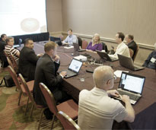
UML 2.0
1994
Booch Method
Rumbaugh OMT Coad/Yourdon
Fire Smith Method
Jacobson OOSE
……
1995.10
Unified Method 0.8
In 2002, UML 2.0 is published
1996.6 UML 0.9
12 companies incl Rational form up UML organization, and then UML 1.0.
In 1997.1, submitted to OMG
1997.11.4, OMG
adopted UML 1.1

Slide 17
9. What is CASE？
Computer-Aided Software Engineering (CASE)
A bunch of tools to support the software enegnieering process
Lower-end tools: to generate codes
High-end tools
to draw enterprise model and application requirements specifications
Notes:
高级CASE工具用来绘制企业模型以及规定应用要求，低级CASE工具用来生成实际的程序代码

Slide 18
10. Problems of Software Engineering
Legacy systems
Changing requirements
Delivery
…
System complexity and details (Mars probe failure)
Technological uncertainty (and in turn the understanding of developers)
Communication barriers
Requirement uncertainty
Constant changes lead to the software degradation
Artificial and the market risk
Costs, reliability, productivity, reusability problems

Slide 19
11. Ethical responsibility
Professional ethics is very important
  Always keep employer and clients’ information confidential
  Realistically express his/her ability to work, do not accept work beyond the capability.
  Should be aware of the laws related to patents, copyrights, etc.
  Avoid computer misuse.
ACM/IEEE/BCS and other organizations issued a Code of Professional Conduct and Ethics (involving only basic moral behavior)
Notes:
BCS: British computer society

Slide 20
Content
Basic Concept of Software Engineering
Computer-based System Engineering
Software Process
Basic elements of software project management

Slide 21
1. System Overall Characteristics
Functional
Non-functional: reliability, security, privacy, safety issues
What relates the system reliability：
  HW
  SW
  Operational

Slide 22
2. System and Its Surviving Environment
Environment is always there
Environment will affect the system's functionality and performance.
In the environment there exisit a series of interactions with other systems. Thus, the environment can be treated as a stand-alone system.
Systems engineer must understand the system environment
  In many cases, the system is to change the environment.
  A system can be affected by environmental changes, and such effects may be difficult to estimate.

Slide 23
3. System Modeling
System modeling describes the components of the system and their relationships (system architecture)
System architecture is generally described in block diagram.
Subsystems
Functional components can be divided into six categories:
  Sensors: Gather information from the environment.
  Actuators: incur the environmental changes
  Computing components: given an input, perform calculations and produce output.
  Communications
  Scheduling: coordination of operations between components.
  Interface

Slide 24
4. Process for Sys Engineering
Req Def
Sun-set
Sys Design
Sys evolvement
Component dev
Sys installation
Sys integration

Slide 25
Subsystem development:
  Parallel
  Frequent modifications beyond the scope of a subsystem may happen (HW? SW?)
  System integration by incremental process
    Hard to estimate the exact timing for a subsystem
    Accurate error-positioning (which subsystem causes the failure?) to reduce the disagreement of different subcontractors

Slide 26
5. Buying Softwares
What is the best way of purchase? Who is the best provider?
Before purchasing, system-level descriptions and architectural design must be done, to make sure which “subsystem” needs to be purchased.
Who is the contractor, and who is the sub-contractor.

Slide 27
Client
Contractor
Subcon1
Subcon2
Subcon3

Slide 28
Content
Basic Concept of Software Engineering
Computer-based System Engineering
Software Process
Basic elements of software project management

Slide 29
1. Software Process Model
An abstract representation of the software process
In practice, multiple models are used.
Four kinds of models
  Life-cycle model (waterfall)
  Evolutionary development model
  Formal methods
  Reuse-oriented development model (OO)

Slide 30
Waterfall
Prob Def
Req Analy
Waterfall
Classic Life Cycle Model
Linear Sequential Model
High-level Design
Low-level design
Dependencies between any two subsequent stages
Defer development after designs
To ensure quality
coding
testing
maintenance

Slide 31
Pros
Development process is essentially in a linear sequence, manageable
Based on "clear and comprehensive requirements“, thus able to achieve satisfactory results

Slide 32
The Impact of Changes
Cost of changes
60~100x
1.5~6x
••••••
1x
Definition
Development
After release

Slide 33
Waterfall Model with Maintenance Circle
Proj Plan
Req Analy
High-level Design
Low-level Design
coding
design
Coding
Req Analysis
Testing
Maintenance Circle
Plan
Operations
Justification

Slide 34
Evolution Development Model
Based on the initial requirement, first develop a prototype for clients. Then, based on the feedback, continuously improve the system until satisfactory.
Requirements can be constantly changed.
Two ways of doing it:
  Working with clients together until delivery
  Prototype is to understand the clients’ needs.

Slide 35
Problems of evolution dev process：
  Where is “process”?
  No clear system architecture
In practice, we use the combined model:
  Waterfall Model with Prototyping
  V Model
  Phased Development Model
  Incremental and Iterative Model
  Spiral Model

Slide 36
Waterfall Model with Prototyping
Validate
Req Analysis
High-level Design
Verify
Low-level design
Coding and unit testing
Prototyping
Integration testing
System testing
Delivery
Maintenance

Slide 37
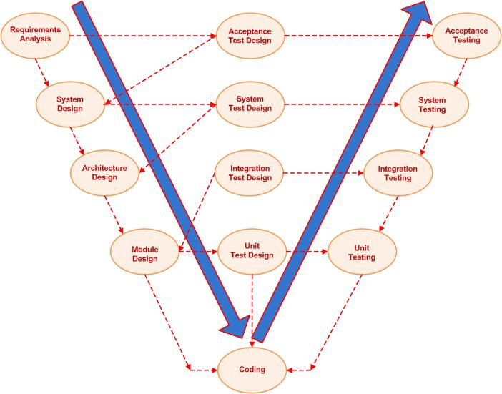
V-Model

Slide 38
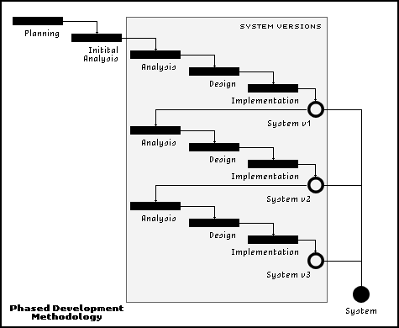
Phased Development Model

Slide 39
The Incremental and Iterative Model
create
 | format
create
edit | format
create
Incremental Development
Paste clumsy | styles
create
Paste easy | More styles
create
Easy quick | More styles
create
Iterative Development

Slide 40
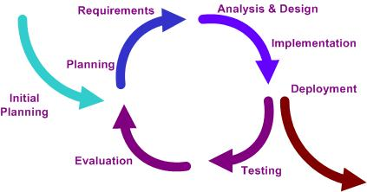
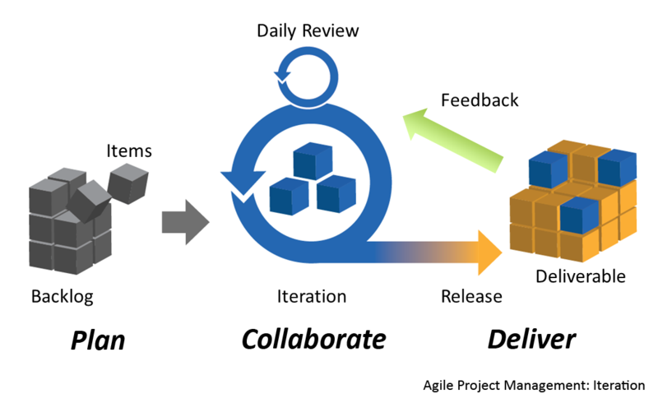
Examples in Agile

Slide 41
Benefits of Incremental Development
Can deliver the product with main functionalities within short period of time
Gradually increase the provided functionalities, so that users have ample time to learn and adapt to the new project

Slide 42
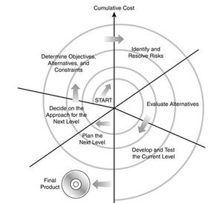
Spiral Model
Notes:
Play this in class: http://courses.cs.vt.edu/csonline/SE/Lessons/Spiral/spiralmodel.html
The spiral model, also known as the spiral lifecycle model, is a systems development lifecycle (SDLC) model used in information technology (IT). This model of development combines the features of the prototyping model and the waterfall model. The spiral model is favored for large, expensive, and complicated projects.
The steps in the spiral model can be generalized as follows:
The new system requirements are defined in as much detail as possible. This usually involves interviewing a number of users representing all the external or internal users and other aspects of the existing system.
A preliminary design is created for the new system.
A first prototype of the new system is constructed from the preliminary design. This is usually a scaled-down system, and represents an approximation of the characteristics of the final product.
A second prototype is evolved by a fourfold procedure: (1) evaluating the first prototype in terms of its strengths, weaknesses, and risks; (2) defining the requirements of the second prototype; (3) planning and designing the second prototype; (4) constructing and testing the second prototype.
At the customer's option, the entire project can be aborted if the risk is deemed too great. Risk factors might involve development cost overruns, operating-cost miscalculation, or any other factor that could, in the customer's judgment, result in a less-than-satisfactory final product.
The existing prototype is evaluated in the same manner as was the previous prototype, and, if necessary, another prototype is developed from it according to the fourfold procedure outlined above.
The preceding steps are iterated until the customer is satisfied that the refined prototype represents the final product desired.
The final system is constructed, based on the refined prototype.
The final system is thoroughly evaluated and tested. Routine maintenance is carried out on a continuing basis to prevent large-scale failures and to minimize downtime.

Slide 43
Benefits of Spiral Model
Software re-use
Software quality is important for dev
Reduce unnecessary/surplus testing
No difference between software maintenance and development

Slide 44

Rational Unified Process (RUP)
By IBM Rational
Highlights
  Use-case driven (functionality)
  architecture-centric (design)
  Iterative and incremental developments (implementation)
  Using UML and other tools
Notes:
统一过程模型是一种“用例驱动，以体系结构为核心，迭代及增量”的软件过程框架，由UML方法和工具支持。

Slide 45

Rational Unified Process
In an iteration, you walk through all workflows
Iterative and incremental development
Use-case driven
Phases
Process Workflows
Inception
Elaboration
Construction
Transition
Business Modeling
Requirements
Analysis & Design
Implementation
Test
Deployment
Supporting Workflows
Configuration & Change Mgmt
Project Management
Environment
Preliminary
Iteration(s)
Iter.
#1
Iter.
#2
Iter.
#n
Iter.
#n+1
Iter.
#n+2
Iter.
#m
Iter.
#m+1
Iterations
Notes:
初始，细化，构造，移交，这是一个循环只得到一个版本，因此循环要进行下去

Slide 46
Formal Methods
Similar to the waterfall model, but
  Requirement descriptions are highly reply on mathematics (e.g., notations, equations...)
  A series of transformations lead to executable programs
Cleanroom Process by IBM
Notes:
净室软件工程(Cleanroom software engineering)是一种在软件开发过程中强调在软件中建立正确性要求的方法。
与传统的分析、设计、编码、测试和调试的周期观点有所不同，
净室软件工程背后的哲学是：通过在第一次正确地书写代码增量，并在测试前验证它们的正确性来避免成本很高的缺陷消除过程。它的过程模型是在代码增量积聚到系统的过程的同时进行代码增量的统计质量验证。

Slide 47
Operational Specification Model
Execute and
Revise
Operational Specification (problem-oriented)
Transformed Specification (implementation –oriented )
TEST
Delivered
System
System
Requirements
(sometimes informal
or incomplete)

Slide 48
Transformational Model
Compare with
requirements;
Update as needed
Formal Development Record
Sequence of transformations
Plus rationale for them
Transform n
Formal Specification problem-oriented
TEST
Transform 2
Transform 1
Delivered
System
System
Requirements
(sometimes informal
or incomplete)

Slide 49
2. Software Descriptions
Feasibility study report
Requirement analysis
Requirement descriptions
Requirement validations

Slide 50
3. Software Designs
Architectural design
Subsystem abstract description
Interface design
Component design
Data structure design
Algorithm design

Slide 51
4. Software Validation
Unit testing
Functional module testing
Subsystem testing
System testing
Delivery testing (α、β、λ)
Notes:
α、β、λ常用来表示软件测试过程中的三个阶段，
α是第一阶段，一般只供内部测试使用；β是第二个阶段，已经消除了软件中大部分的不完善之处，但仍有可能还存在缺陷和漏洞，一般只提供给特定的用户群来测试使用；λ是第三个阶段，此时产品已经相当成熟，只需在个别地方再做进一步的优化处理即可上市发行。 在软件交付使用之后,用户将如何实际使用程序, 对于开发者来说是无法预测的.
α测试是由一个用户在开发环境下进行的测试,也可以是公司内部的用户在模拟实际操作环境下进行的测试. α测试的目的是评价软件产品的FLURPS(即功能,局域化,可使用性,可靠性,性能和支持).尤其注重产品的界面和特色. α测试可以从软件产品编码结束之时开始,或在模块(子 系统)测试完成之后开始,也可以在确认测试过程中产品达到一定的稳定和可靠程度之后再开始.
β测试是由软件的多个用户在实际使用环境下进行的测试.这些用户返回有关错误信息给开发者. 测试时,开发者通常不在测试现场.因而,β测试是在开发者无法控制的环境下进行的软件现场应用. 在β测试中,由用户记下遇到的所有问题,包括真实的以及主观认定的,定期向开发者报告. β测试主要衡量产品的FLURPS.着重于产品的支持性,包括文档,客户培训和支持产品生产能力. 只有当α测试达到一定的可靠程度时,才能开始β测试.它处在整个测试的最后阶段.同时,产品的所有手册文本也应该在此阶段完全定稿.

Slide 52
5. Software Evolution
Definition: Software evolution is the term used in software engineering (specifically software maintenance) to refer to the process of developing software initially, then repeatedly updating it for various reasons.
The nature of software flexibility determines that software evolution is a must
  Avoid expensive HW modifications
Can be regarded as an integrated process between dev and maintenance

Slide 53
6. Software Automation
CASE
Limitations
  By essence, software engineering is a creative activity
  Software process emphasizes the team work

Slide 54
Content
Basic Concept of Software Engineering
Computer-based System Engineering
Software Process
Basic elements of software project management

Slide 55
Software Project Management
Software PM needs to take a variety of different tasks, one of the most important activities are project planning, estimating costs and schedule control.
Project milestone is something that is expected and planned.
When reaching a milestone, PM needs to report the progress to the mangement board.
In order to effectively track/control the project progress, PM can use a variety of charts/diagrams.
Should identify and assess the project risk, determine the likelihood of these risks and consequences.

Slide 56
1. What to Manage?
People management
Budget control
Quality control
Process improvement
Software configuration management

Slide 57
2. Project Planning
Essence is to estimate the potential risks and adopt effective method to solve the problems
Contents:
  Project plan
  Quality plan
  Configuration management plan
  Maintenance plan
  Training plan
  …

Slide 58
3. Resource Planning
PM needs to estimate the amount of “resources” to use in order to complete the project, and organize these resources in an optimal way. They are:
  HW
  SW
  Costs
  Space
  People
  Time
  …

Slide 59
4. Risk Management
Identify the potential risks and make the plan, to maximally lower their impact to the project
Three types of risks
  Product：that have impact on the software quality and performance
  Project：that have impact on the project progress and resources
  Business：that have impact on the software company and/or clients
How to manage the risks?
  Identification, analysis, plan, and monitoring

Slide 60
Potential Software Risks
Risks | Type | Descriptions
Staff quit | project | Experienced staffs
Re-org | project
Lack of HW | project | e.g., ordered HW is not delivered
Change of req | project | inevitable
Description delay | Project& product
Underestimate the system scale | Project& product | Over budget
Poor CASE perf | product | Some CASE tools are very expensive
Tech change | Biz
Peer competition | Biz

Slide 61
Risk Analysis
Risks | Possibility | consequence
Financial problems, to cut the budget | Low | Significant
Lack of qualified staff | High | Significant
Staff report sickness at important stage | Medium | Significant
Defect on re-useable components | Medium | Significant
Req change leads to re-design | Medium | Significant
Re-org | High | Significant
Database problem | Medium | Significant
Underestimate the dev efforts (time) | High | Significant
CASE tools cannot be used | High | Tolerable
Clients not sure of the req | Medium | Tolerable
Lack of training | Medium | Tolerable
Underestimate the software size | High | Tolerable
Codes generated by CASE tools are inefficient | Medium | Negligible

Slide 62
Causes of Software Risks
Type | Potential risks | Examples
Tech | DB, re-useable components, or COTS | HW/SW delivery delay, exposes too many tech problems
Staff | Recruitment, staff changing jobs, training | Tasks are not assigned properly, team internal chaos
Org | Re-org, financial problems
Tools | CASE tools | Using tools are not easy
Req | Change, misunderstanding, communications | Too much changes, client complaints
Plan | Underestimate the software size, timing, defects | Progress is delayed

Slide 63
Risk Management Strategies
Risks | Strategies
Financial problems | Draft a report to the mgmt team, explain the impact to the project
recruitment | Tell clients the potential risks/delay this may cause
Staff sickness | Re-form the dev team, flexible task assignment, efficient communications.
Component defect | Purpose reliable components
Req change | Evaluate the impact of change, increase the traceability of the dev process
Re-org | Draft a report to the mgmt team, explain the impact to the project
DB performance | Purpose high performance DB

